Slide 1


Final Project FDS
Fabrizio Rossi 1815023
Matteo Orsini 1795119
Mina Makar 1804475

Slide 2
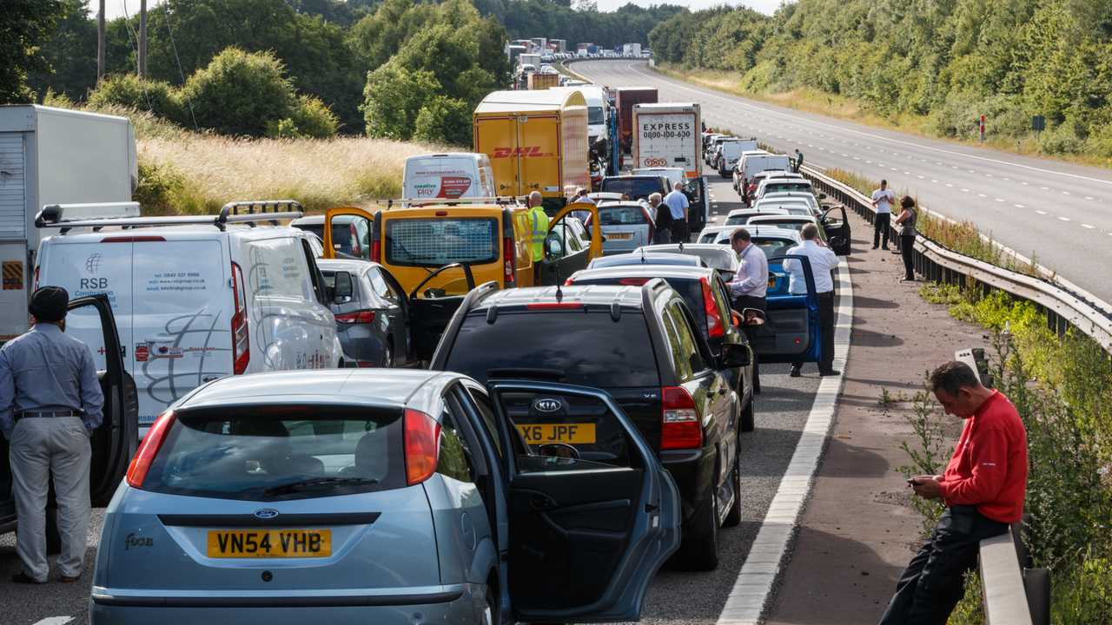
Task and motivation
Classify the effects on the traffic of an accident on a scale {1, 2, 3, 4}
Could be useful to take actions to regulate the traffic when an accident occurs
Notes:
The task we chose for the final project is to classify the effects on the traffic of an accident, rated on a scale that goes from 1 to 4. 1 means that the accident will have a low impact on the traffic, maybe causing short delays, while 4 means a very high impact, meaning high delays.
We thought that this could be useful to take actions to regulate the traffic when an accident occurs, by predicting the severity of the accident.

Slide 3
Models and tools
We would like to:
Implement our solution from scratch
Use pandas library to process the features
Use scikit-learn for the machine learning tools
In particular, we would like to test the following models:
Logistic regression
Naive Bayes
SVM
Neural Networks
Notes:
As project type, we chose an application project, meaning that we would like to implement our solution from scratch.
We are not going to implement everything by hand but we will use some libraries to help us in the developement like
pandas to process the features and scikit-learn to implement machine learning models.
In particular, we would like to test the following models:
Logistic regression
Naive Bayes
SVM
Neural Networks

Slide 4
Analysis
We are going to use a Kaggle dataset about US accidents with about 3.5 million records and 50 features (road features, weather infos, gps position, time) to fit the models https://www.kaggle.com/sobhanmoosavi/us-accidents
We are going to compute the following metrics:
  Accuracy
  Precision
  Recall
  F1-score
  PR Curve
Notes:
To fit the models, we found a dataset on Kaggle which contains informations of about 3.5 million of accidents occured in the US.
Each accident record has about 50 features containing road features, weather informations, gps position and informations about the time of the event.
In order to evaluate each model we would like to compute the metrics we’ve seen during the curse, like:
Accuracy
Precision
Recall
F1-score
PR Curve

